Slide 1


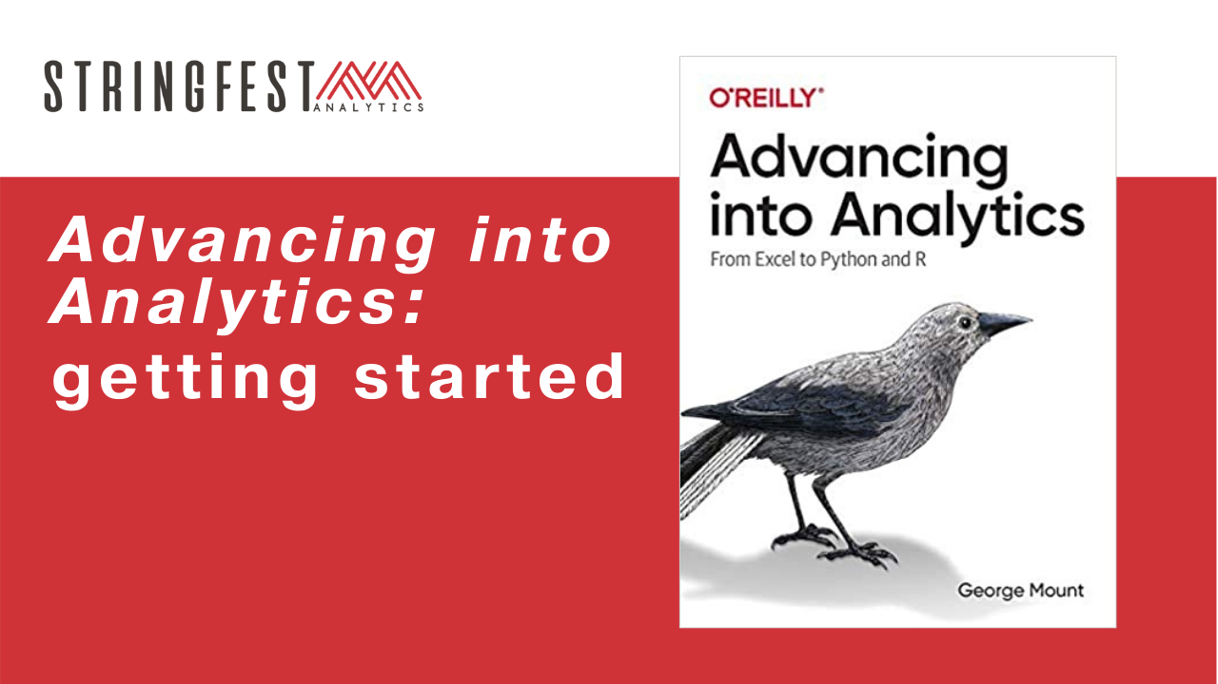
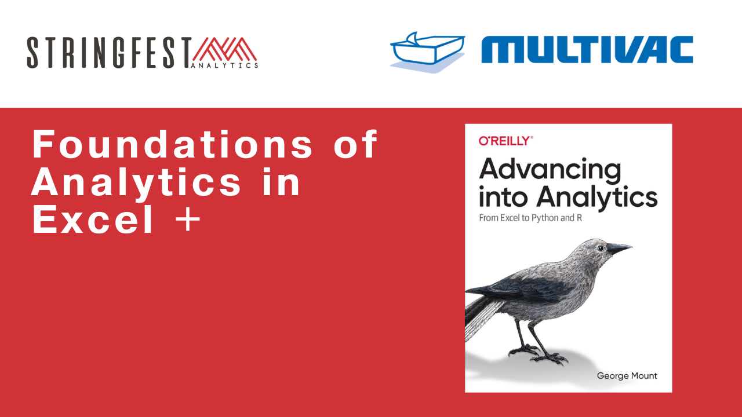
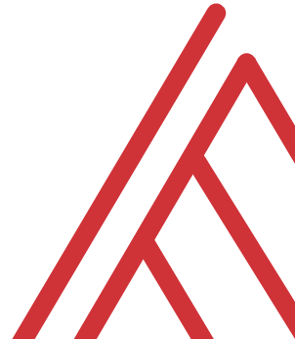
Advancing into Analytics: From Excel to R and Python

Slide 2
Follow along
Download resources: https://swiy.co/mv-download
Unzip folder

Slide 3
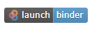
Follow along
Download and unzip resources: https://github.com/stringfestdata/python-for-excel-users-crash-course
Follow along …. →

Slide 4
Questions?
Notes:
Any questions so far about using R?
Again I just want to show you how easy it is to get up and running there as an Excel user and what to expect when working with open source programs.
Now I guess one of the questions I might have in your shoes is what’s the big deal, we can do the same kind of stuff with Power Query. So I want to acknowledge that.

Slide 5
Objectives for today
Clean data in Excel
Analyze it in Excel
Script it all in Python
Notes:
So this means anyone is free to build on it or redistribute it… and that’s how we’ll get our code

Slide 6
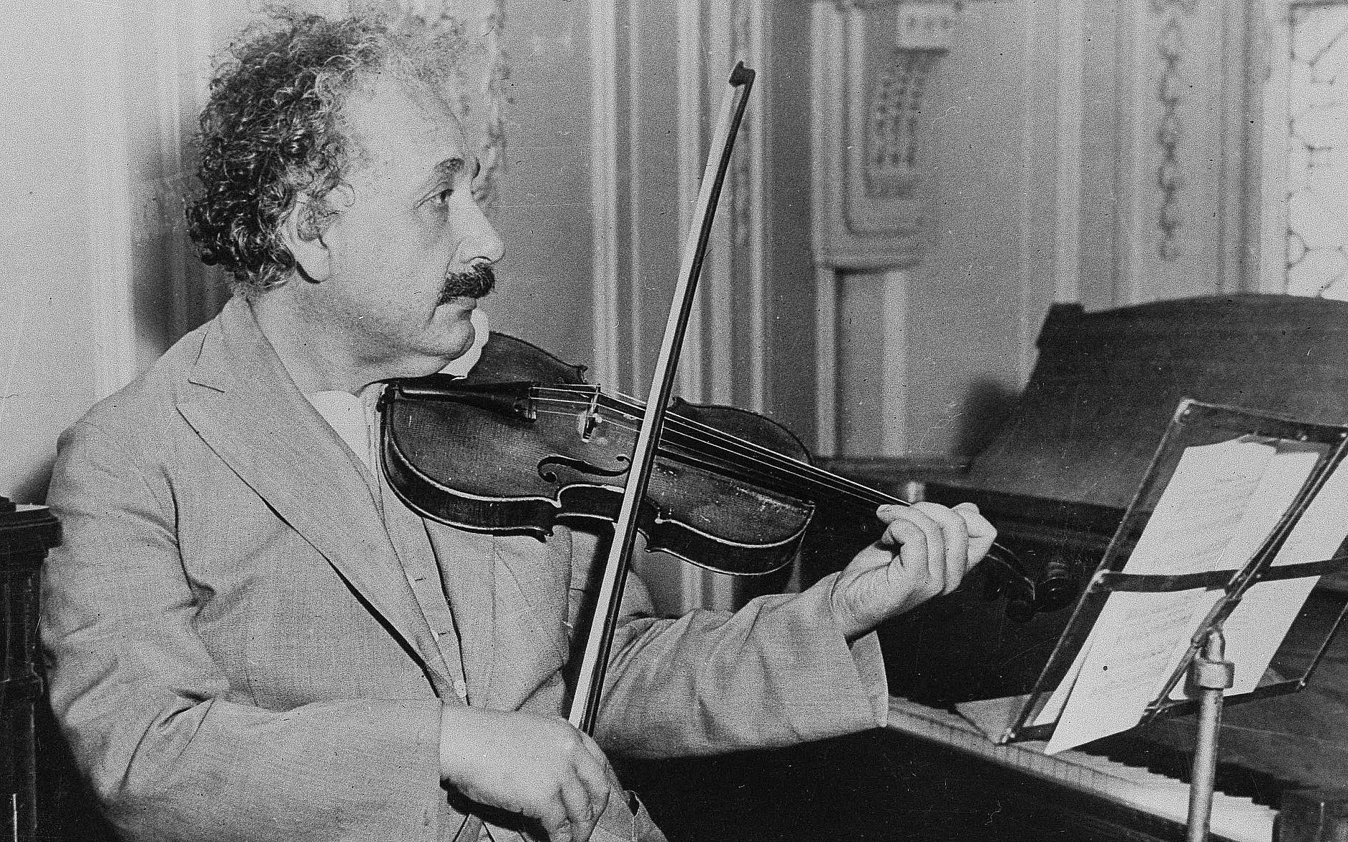


3 Fun Facts about me
Like Einstein in this one way…
My Duolingo jam
This was never me…
Notes:
So this means anyone is free to build on it or redistribute it… and that’s how we’ll get our code

Slide 7
~3 Fun Facts about you
… plus your learning objectives
Notes:
So this means anyone is free to build on it or redistribute it… and that’s how we’ll get our code

Slide 8
Tentative schedule
Notes:
So this means anyone is free to build on it or redistribute it… and that’s how we’ll get our code

Slide 9

Objectives for today
No question too big or small
Balance actual & plan
This is your time… unkempt and unanalyzed data’s time is over.
Notes:
So this means anyone is free to build on it or redistribute it… and that’s how we’ll get our code

Slide 10
Questions?
Notes:
Any questions so far about using R?
Again I just want to show you how easy it is to get up and running there as an Excel user and what to expect when working with open source programs.
Now I guess one of the questions I might have in your shoes is what’s the big deal, we can do the same kind of stuff with Power Query. So I want to acknowledge that.

Slide 11
Importing the data… Power Query

Slide 12

LESSON OBJECTIVES
Load data from Excel workbooks and csv files into Power Query
Perform common data wrangling and cleaning tasks
Combine data from multiple sources

Slide 13
FOLLOWING ALONG
Each section is a sub-folder
Demos = follow along with me
Drills = try it yourself
Refresh your memory with the demo notes
Notes:
This is an Excel class, so we won’t be looking at PowerPoint the whole time – to follow along, you will see that all assets are divided by section.
Some of our Excel time will be Demos – for this I will be walking through some procedure in Excel.
If you need any datasets they will be included in each sub-folder.
Then there may be a Drill where you will work on it for yourself during some specified period of time.
I have provided written notes/instructions about the Demos which you can refer to while working on the Drills.

Slide 14
1. POWER QUERY AS EXCEL’S ETL TOOL
Notes:
One thing you’ll see that’s interesting about Power Query is that is has brought a lot of best practices in IT into Excel, one of those being the “extract, transform and load” methodology. So, I want take a brief pulse check here, is this a term you have heard of before? And honestly if you don’t, that’s why you are here.

Slide 15

What the @%&! is ETL?
“A properly designed ETL system extracts data from the source systems, enforces data quality and consistency standards, conforms data so that separate sources can be used together, and finally delivers data in a presentation-ready format so that application developers can build applications and end users can make decisions.”
-- (where else but) Wikipedia
Notes:
Now I’m going to be very scientific here and go to Wikipedia to explain how extract, transform, load or ETL methodologies work.

Slide 16








2. TRANSFORM
1. EXTRACT
3. LOAD
Notes:
So, you can see ETL achieves quite a few purposes, and as the name implies it works in three steps:
- First, you want to extract the information from some outside source, this can be anything from a database to a web page.
- Then, you want to transform it. This could be cleaning the data, filtering it, checking for assumptions, you get the idea.
- Finally, loading the data, this places it in a format that is accessible for end users to work with.
https://unsplash.com/photos/QUHlPs4y8PQ
https://pixabay.com/photos/tee-tea-bags-teas-drink-herbal-tea-1252397/
https://pixabay.com/photos/construction-worker-welding-welder-1717893/
https://pixabay.com/photos/gift-box-gifts-packaging-box-2458012/

Slide 17

Power Query & Excel Myth-busting
https://giphy.com/gifs/mythbusters-gif-qVuWpc7MxvGz6
Notes:
As I mentioned, ETL is all over the IT landscape and is considered a best practice when you are working with large amounts of disparate data that need to be “fit for general office consumption.” It’s not just an Excel thing, and in fact this is a pretty disruptive tool to have in Excel, and it really busts a lot of the myths about what Excel can and can’t be which I would like to cover right now.

Slide 18

1. “EXCEL IS NOT REPRODUCIBLE”
Notes:
https://pixabay.com/photos/laboratory-analysis-chemistry-2815641/
Now, the idea of reproducibility is that, the process of getting to some output is fully transparent and it’s possible to walk through each step of the process and get the same result at the end. A lot of typical Excel reporting is not fully reproducible, for example consider a report that depends on you deleting columns A through C to work. Now, if I was going into that final report to understand how it was built, there would really be no way for me to know that, right? On the other hand, a fully reproducible report would show me that, and ideally I’d just click a button and it would do it for me.
In data work, reproducibility is often achieved by powering an analysis with code, so that you can indeed run a script and watch the results emerge one line at a time. Now, the nice thing about Power Query is that it is a code-driven process, so it is reproducible. So does this mean you need to learn how to code in this class? Not necessarily right now. For everyday data cleaning processes, we can use menu-driven options, that will produce code in a Microsoft computer language called M, and now our data-cleaning steps are fully reproducible, in Excel, with no code needed. So that is really cool and a huge myth busted.

Slide 19

2. “EXCEL ONLY DOES STRUCTURED DATA”
Notes:
https://pixabay.com/illustrations/grid-isolation-table-lamp-beetle-2088884/
This is the type of data that in fairness we are more used to working with in classic Excel, data that comes in a nice rectangular shape, usually coming from an Excel workbook or csv file. If the data were in a so-called “unstructured” format, such as song lyrics or a website structure, good luck with using Excel for that.
Come over to Power Query and there is quite an expanded range of possibilities for where data can come from [list on the next page]

Slide 20
Access
.txt and .csv files
SQL Server & other relational databases
XML, HTML & Web data
SharePoint
Hadoop
oData
Combinations of the above…
Notes:
All these types of data and more are fair game to be loaded into Power Query. Where things get really interesting is you are able to combine data from these disparate sources into one consumable data source.

Slide 21

3. “EXCEL CAN’T HANDLE LARGE DATASETS”
Notes:
And that’s the last myth I want to bust here, is that Excel can’t handle large datasets. Now, with “classical Excel” this was probably true, that Excel just couldn’t handle some of those bigger datasets that a lot of data analysts are working with these days, but that’s just not true when you are using Power Query [example on next slide]
https://pixabay.com/photos/amphibian-turtle-animal-armor-blur-1850190/

Slide 22
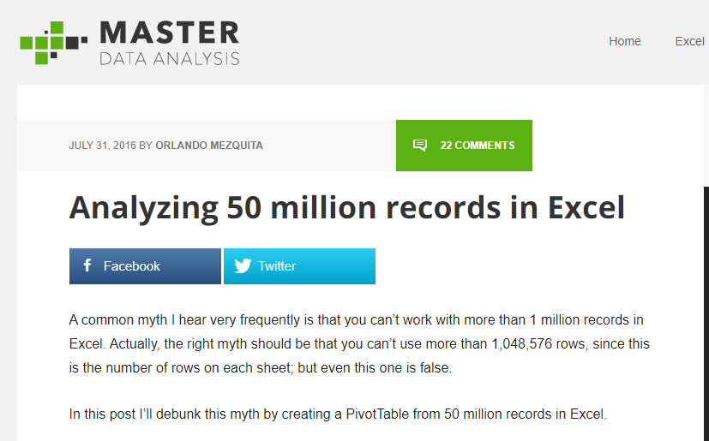
https://www.masterdataanalysis.com/ms-excel/analyzing-50-million-records-excel/
Notes:
Here is an example of that, a blog post about analyzing 50 million records using Excel. 50 million is pretty significant for most anyone, and Excel could handle it, so dismissing Excel out of hand on account of performance is just not as true anymore with Power Query.

Slide 23
What did we do before Power Query?
File: wholesale-customers.xlsx
How would you make this data “PivotTable-ready?”
Notes:
Now you are hyped up Power Query, I think you are going to love it and it will be hard for you to remember the days when you didn’t have it. So let’s think about what we would do without Power Query.

Slide 24
QUESTIONS?

Slide 25
2. WHAT MAKES DATA TIDY?
Notes:
An example that should sound familiar to you as a data analyst follows on the next slide.

Slide 26
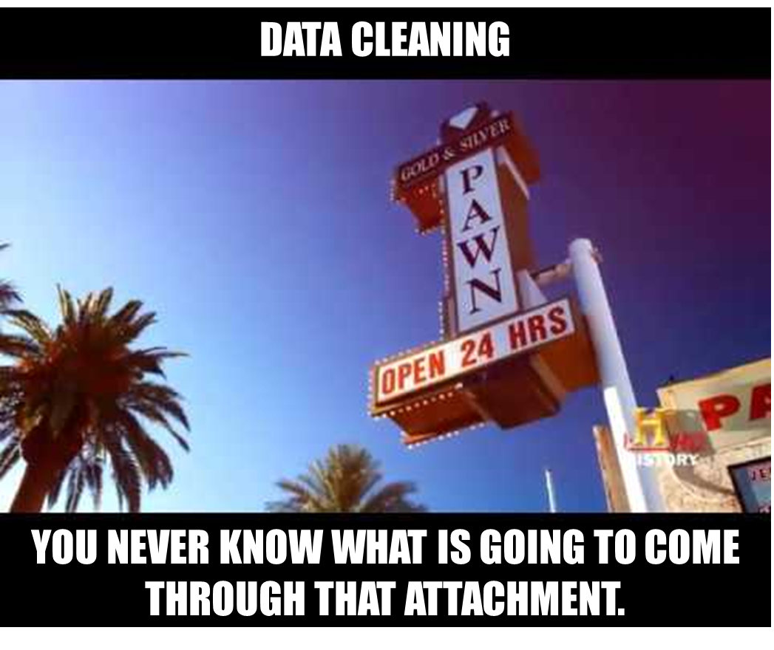
Notes:
It’s not even like a box of chocolates, because we KNOW we are going to get something dirty & unfit for consumption.
If you do anything with data you know how much time is spent cleaning it. You never know what is going to come through that attachment.
And Power Query will indeed help you automate some of these process that you go through every week, such as deleting columns, sorting rows, etc, and you won’t necessarily have to write code like you would have in VBA. But what Power Query can’t tell you is how the data should be shaped. You should have some “attack plan” when you encounter a dataset so that you are “beginning with the end in mind,” that is, a dataset that will be easy to analyze.

Slide 27
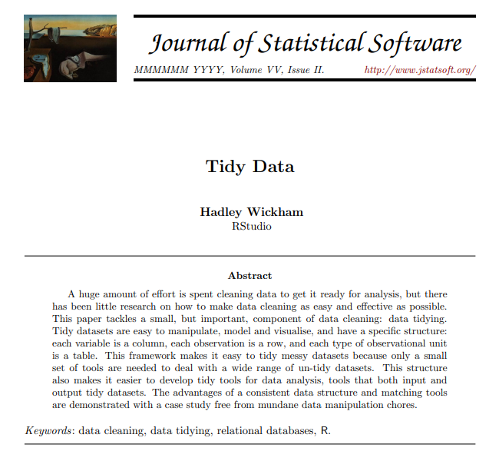
TIDY’S ORIGINS
http://vita.had.co.nz/papers/tidy-data.pdf
Notes:
And the paradigm we will borrow from to do that comes from Hadley Wickham, a statistician and prolific author of R packages. Wickham wrote a paper called Tidy Data that gave some pointers for how to clean datasets so that they are optimized for analysis.
I have included a copy of this paper in the repo, you can also download it at the link.

Slide 28
OBSERVATIONS AND VARIABLES
Observation: The unit that was measured
Variable: What was measured
Notes:
It’s really pretty brilliant and like a lot of brilliant ideas, it’s rather simple: We want to break our data into two categories, observations and variables. There are also sometimes called dimensions and measures. A good way to think about this is that observations are going to be fixed by the design of our data collection, and variables will be measured during the course of the experiment.
So, if you are measuring the heights of individuals, each person would be an observation, and height would be the variable.
It’s one of those concepts that “you know when you see,” so let’s practice a little more.

Slide 29
DRILL
Which attributes are observations, and which are variables?
Attribute | Observation or variable?
Store #
Month
Sales
Notes:
Which is which? [Answers on next slide]

Slide 30
DRILL
Which attributes are observations, and which are variables?
Attribute | Observation or variable?
Store # | Observation
Month | Observation
Sales | Variable
Notes:
One thing to consider here is that observations do not necessarily have to be “letters,” for example Month could be represented as 1,2,3 or Jan,Feb,Mar.
So, what does this distinction have to do with data cleaning? [next slide]

Slide 31
WHAT MAKES DATA TIDY?
Notes:
We want to have our data organized so that each variable is its own column, and each observation is its own row. So, if you remember our wholesale sales dataset, Category would have been an observation, and Sales a variable. We should have had Sales as one column, and then Category went down the rows.
There is one more principle of “tidy” data that we will not explore, it gets into concepts related to database normalization, but for our purposes thinking about having every variable in its own column is going to be of tremendous help.
We should also remember that every cell should be some populated intersection of an observation/variable! That means that merged cells, unrepeated fields, even totals are not going to be tidy for us. We want it in this form to analyze.
And you can get a sense of some of these pain points if you have ever built a PivotTable, it does not take kindly to some of these cosmetic tweaks that are often made to datasets. To practice what some of those tweaks are and what we would want to do to get the dataset to tidy, a couple of drills follow.

Slide 32
DRILL
How would we tidy this dataset?
(Don’t do, just think)
Notes:
What if you were given a dataset like this, what would you do with it so you could actually analyze it?
Note that you don’t actually have to re-shape this data, just think through what changes you would want to make.

Slide 33
SOLUTION
Notes:
A few things, right? First, get rid of all the excess rows and columns, unmerge and rotate the Model headers, move the Regions into a new column. You’ll see that this data moves from being “short and wide” to “tall and narrow” and that is one of those colloquial hallmarks of what happens when you make a dataset easier to analyze.
Let’s try one more.

Slide 34
DRILL
How would we tidy this dataset?
(Don’t do, just think)
Notes:
Here’s another one, how would you clean it up? Don’t actually do it, just think through it.

Slide 35
SOLUTION
Notes:
Same idea here, right? We have a “tall and narrow” dataset now.
To the uninitiated this does not look like a very helpful dataset, because look how many things are repeating, right! I mean we had such a nice little compact table before and now it’s this really long table.
However for the purposes of actually analyzing this data, this is a preferred state, because now we are free to re-summarize and re-aggregate as each observation now makes its own row, and each variable is its own column.

Slide 36
QUESTIONS?
Notes:
This all may seem like a lot of wind-up but it’s easy to over-emphasize the technology. It can’t tell us what to do. So before we start to use Power Query to clean data, we should have an idea of what clean data actually is!

Slide 37
3. FIRST STEPS IN POWER QUERY
Notes:
Let’s finally get into Power Query! We won’t really clean or transform anything here, but we will see an awesome built-in Power Query tool for exploratory data analysis.

Slide 38
DEMO
File: star.xlsx
Load into Power Query
Explore via Data Preview
Refer to demo notes
Notes:
Open this file. We will get into Power Query now.

Slide 39
DRILL
File: computers.xlsx
Load into Power Query
Explore via Data Preview
Don’t forget the Demo Notes if you get stuck
Notes:
Now do the same for the computers file.
Reminder that if you don’t remember how I did something in a demo, you can refer to the demo notes for written instructions.

Slide 40
QUESTIONS?
Notes:
Any questions on descriptive statistics?

Slide 41
4. TRANSFORMING ROWS IN POWER QUERY
Notes:
In this section we will do some common row-wise data transformation such as sorting, removing duplicates, filtering, filling and grouping a table

Slide 42
DEMO
File: office-rsvps.xlsx
Notes:
Any questions on descriptive statistics?

Slide 43
DEMO
File: regional-sales.xlsx
Notes:
Any questions on descriptive statistics?

Slide 44
DRILL
File: state-populations.xlsx
Worksheet: states
Name the query State populations.
Remove the United States row from the data.
Fill down blanks on the Region and Division columns
Sort by Population from high to low
Load results into a PivotTable
Worksheet: midwest_cities
1. Convert this data into a table where each city is in its own row.
Notes:
Any questions on descriptive statistics?

Slide 45
QUESTIONS?
Notes:
As you saw with the last solutions one of the best ways to learn is just to go the extra mile with your data sets, ask “what if” and start to play around. I can’t possibly show you all the row-wise operations because it’s really infinite in Power Query so the best thing we can do is with these little case studies where we start to play around with different options and combinations based on what we want to do with the data.

Slide 46
5. TRANSFORMING COLUMNS IN POWER QUERY, PART I
Notes:
Now, we’ve worked on making row-wise transformations, let’s focus on the columns. We may want to do things like reformat a column, change its data type or split is based on some delimiter.

Slide 47
DEMO
File: dvdrentals.xlsx
Notes:
Let’s practice on this DVD rentals dataset, this comes directly from this website, and we just want to do some various things to this data, so as always let’s do a Data, From Table, and now we are in our Query editor and we can do a few things.

Slide 48
DRILL
File: orders.xlsx
Convert the Date column to a month data type.
Convert the Account column to proper case.
Split the Opportunity column into three columns:
Vendor
Status
Order Type
Notes:
Any questions on descriptive statistics?

Slide 49
QUESTIONS?
Notes:
Some of what we did you may be familiar with – text to columns, reformatting a column, but actually changing a data type is different – we aren’t just cosmetically changing the data, or parts of the data, in Power Query, we are actually converting its type and that is really a different way of doing things, almost more like what you would do in a database. Pretty cool. Let’s continue with some more sophisticated column-wise transformation.

Slide 50
6. TRANSFORMING COLUMNS IN POWER QUERY, PART II
Notes:
This section will actually be in two parts.

Slide 51
6A. Transforming Columns
Notes:
First we will continue with some column transformations, in particular we will create calculated fields and then un-pivot a table.

Slide 52
DEMO
File: population-densities.xlsx
Notes:
Any questions on descriptive statistics?

Slide 53
DRILL
File: wholesale-customers.xlsx
Tidy this data!
Create a field calculating 10% of the sales called Tax
Notes:
Any questions on descriptive statistics?

Slide 54
6B. Appending Tables
Notes:
Next we will start to operate on multiple tables at a time, first by appending two or more tables together, which in some ways is a row-wise operation, but it’s based on columns so I think it still counts ☺

Slide 55
DEMO
Files: oscars_yes.csv, oscars_no.csv
Start with a blank Excel workboook
Notes:
Now we will switch it up a little bit

Slide 56
DRILL
File: hof_inducted.csv, hof_not_inducted.csv
Append these tables
Notes:
Any questions on descriptive statistics?

Slide 57
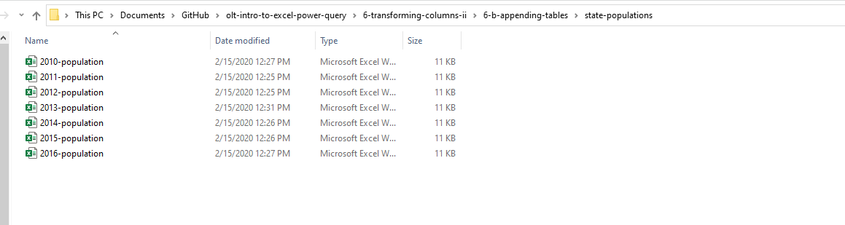
DEMO
Append from a folder of files:
Folder: state-populations

Slide 58
DRILL
baseball folder
This is a download of the csv version of the Lahman baseball database.
See if you can get a table of all files in this folder using Power Query.
In this case we do not want to transform the data, just load a table of the file metadata.
Notes:
This is actually the source data of the hall of fame tables.

Slide 59
QUESTIONS?
Notes:
Any questions on descriptive statistics?

Slide 60
QUESTIONS?
I have one:
Who are these people?
Notes:
It looks like the first two names are Ty Cobb and Babe Ruth but how would I know that for sure? It’s not English? Why are we using these? If you have done a lookup before you may know why. We are going to get a lot more advanced with them

Slide 61
6. VLOOKUP(), MEET JOIN

Slide 62
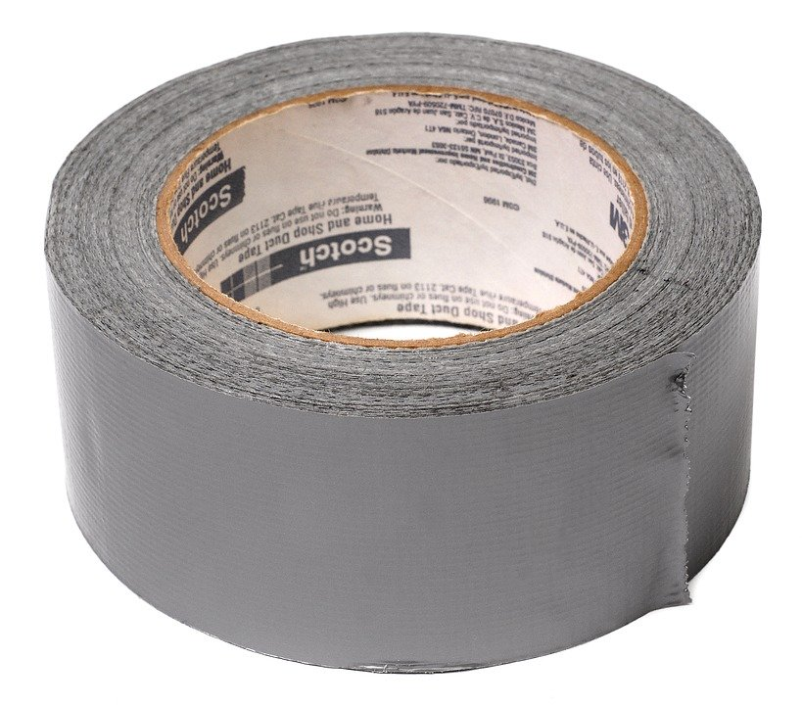

DUCT TAPE, MEET WELDER
VLOOKUP()
JOIN

Slide 63
DEMO
File: flights-and-planes.xlsx (the VLOOKUP way)
Notes:
Any questions on descriptive statistics?

Slide 64
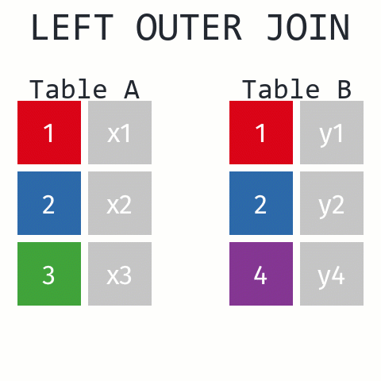
Returns ALL records from Table A and matching records from Table B. Results with no match are null.
https://github.com/gadenbuie/tidyexplain#mutating-joins

Slide 65
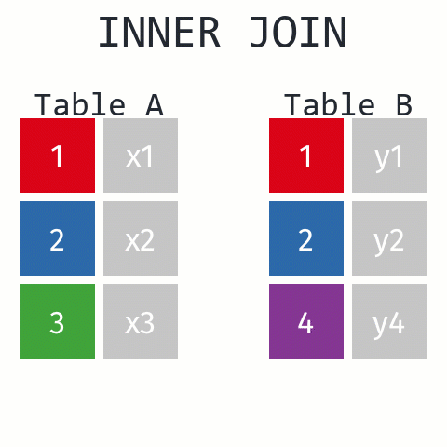
Returns records that have matching values in Tables A and B
https://github.com/gadenbuie/tidyexplain#mutating-joins
Notes:
These are R functions but the idea is the same.

Slide 66
DEMO
File: flights-and-planes.xlsx (the Power Query way)
Notes:
Now, let’s see what happens with our data when we use a join versus a lookup.

Slide 67
DRILL
Files: hof.csv, people-a-thru-m.csv
What is the result of a left outer join of hof on people-a-thru-m?
What about an inner join?
Notes:
Our source data only contains a list of the people with last names A thru M. How will this affect an inner join versus an outer join.

Slide 68
QUESTIONS?
Notes:
Any questions on descriptive statistics?

Slide 69
JOIN Beyond the basics

Slide 70
DATABASE JOIN TYPES
LEFT OUTER
RIGHT OUTER
A
B
A
B
FULL OUTER
A
B
INNER
A
A
LEFT ANTI
RIGHT ANTI
A
B
A
B

Slide 71
DEMO
File: championships-demo.xlsx
Which cities can claim only a baseball or football championship?
Left anti
Right anti
Baseball
Football
Baseball
Football
Notes:
Let’s imagine that our baseball team is the Left table and the Football teams is the Right table. If I only want the records of cities who have a baseball championship I can use a left anti. Vice versa for football cities.

Slide 72
DRILL
File: championships-drill.xlsx
Which cities can claim only a hockey or basketball championship?
Notes:
The illustrations follow on the next slide.

Slide 73
JOINS CAN GET EXOTIC
Cross join
TABLE A
TABLE B
1
2
3
1
2
3
https://www.tutorialgateway.org/sql-cross-join/
Notes:
Let’s look at another type of join that is often not listed as a join type but actually is and that is a cross or Cartesian join.

Slide 74
DEMO
File: office-employees.xlsx
Notes:
Any questions on descriptive statistics?

Slide 75
DRILL
Files: states.xlsx
Create a table to record each state’s bird, flower and capital
Notes:
Any questions on descriptive statistics?

Slide 76
QUESTIONS?
Notes:
Any questions on descriptive statistics?

Slide 77
7. CONCLUSION
Notes:
Thank you everyone for coming today, as you have seen Power Query is a beast. There is so much you can do, it really opens up the doors to not just Excel but the Microsoft BI stack as a whole, so let’s see what I mean here.

Slide 78
What to learn next?
M language
PowerPivot
Power BI
Notes:
As you are going to see, learning Power Query can take you in a lot of different directions, which is pretty mind blowing, because there are just so many ways to go and things to learn these days.
Manipulating the M language: This will let you write things like custom functions. This will also be a good gateway into things like re-using queries and customizing what stuff does.
Power Pivot: This is the data modeling language. So if you wanted to build something like a relational schema inside a workbook, and again this can be with data coming from all types of places, and you can even use Power Query to clean up that data and then Power Pivot to build relational models, pretty cool dynamic duo.
Power BI: This is the dashboarding/reporting/visualization part of the Microsoft BI stack. The cool thing is you’ve got a leg up for learning this, because Power BI also has Power Query!

Slide 79
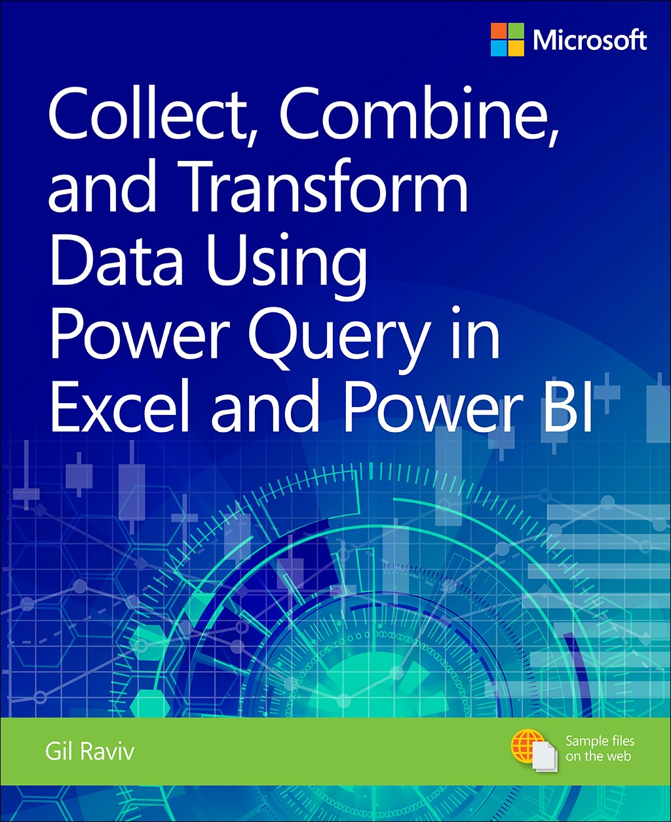
Collect, Combine, and Transform Data Using Power Query in Excel and Power BI, 1st Edition
by Gil Raviv
On O’Reilly Learning at https://learning.oreilly.com/library/view/collect-combine-and/9781509307982/
Human Centered Design • MDLS 2020
Notes:
This one is a real tour de force in pushing your Power Query capabilities, it will also show you Power BI stuff if you are interested in that.

Slide 80
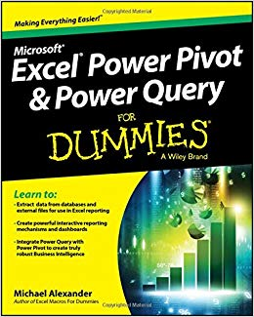
Excel Power Pivot and Power Query For Dummies,
by Mike Alexander
On O’Reilly Learning at https://learning.oreilly.com/library/view/excel-power-pivot/9781119210641/
Human Centered Design • MDLS 2020
Notes:
This one is a little more user friendly, it focuses on Excel and you will also learn about Power Pivot as well.

Slide 81
QUESTIONS?
Notes:
Any questions on descriptive statistics?

Slide 82
Excel to Python (and back)

Slide 83

Lesson objectives
Python and Excel: yes, and
Breaking through with Python
Automating with Python
Agenda:
Use cases
Five things to know
Demo
Notes:
So this means anyone is free to build on it or redistribute it… and that’s how we’ll get our code

Slide 84


Where are these tools letting you down?
Does Power Query and the ToolPak handle it?
What else is available?
Notes:
Because PQ and the Toolpak can handle a lot. Otherwise Microsoft wouldn’t have build them. But at the same time Python can handle a lot otherwise that wouldn’t be under development.

Slide 85

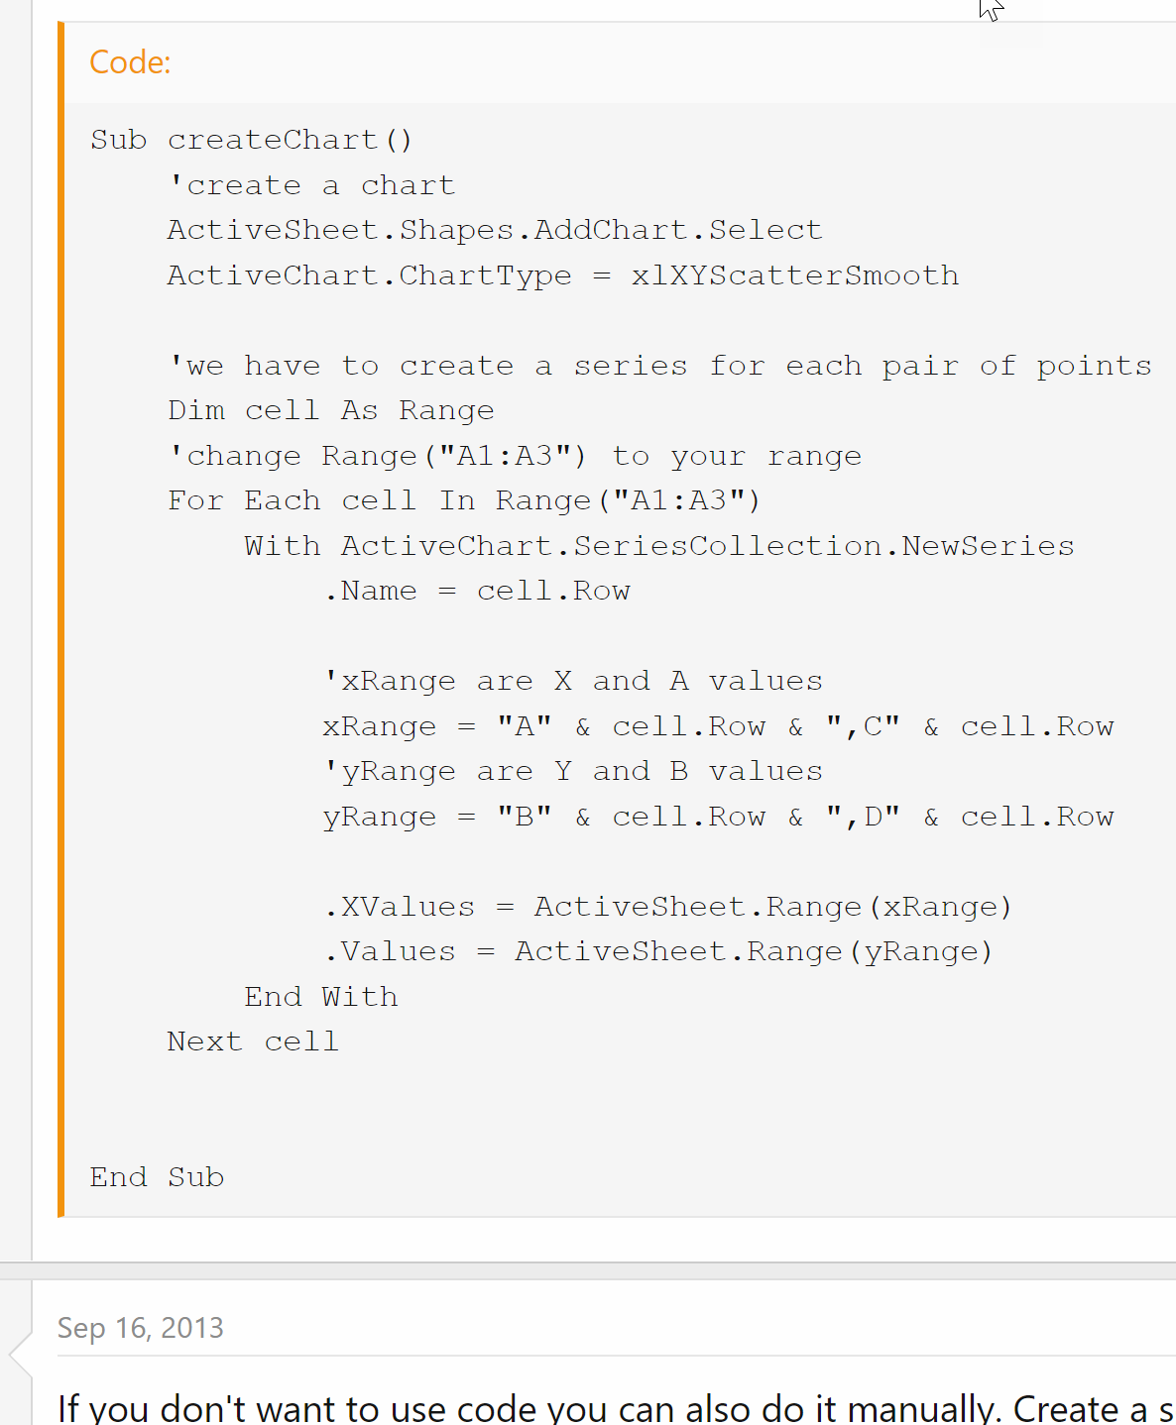
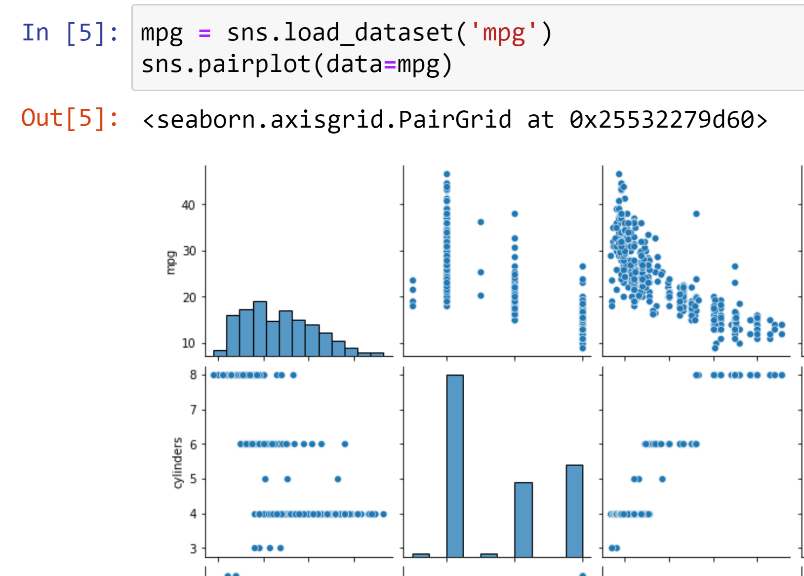
“I want to make a scatterplot for every pair of variables”
https://www.mrexcel.com/board/threads/excel-2010-plot-lines-between-multiple-ordered-pairs.726760/
https://gist.github.com/summerofgeorge/cb214a5c350c378b2107c5cc6385e73f
Notes:
So this means anyone is free to build on it or redistribute it… and that’s how we’ll get our code

Slide 86
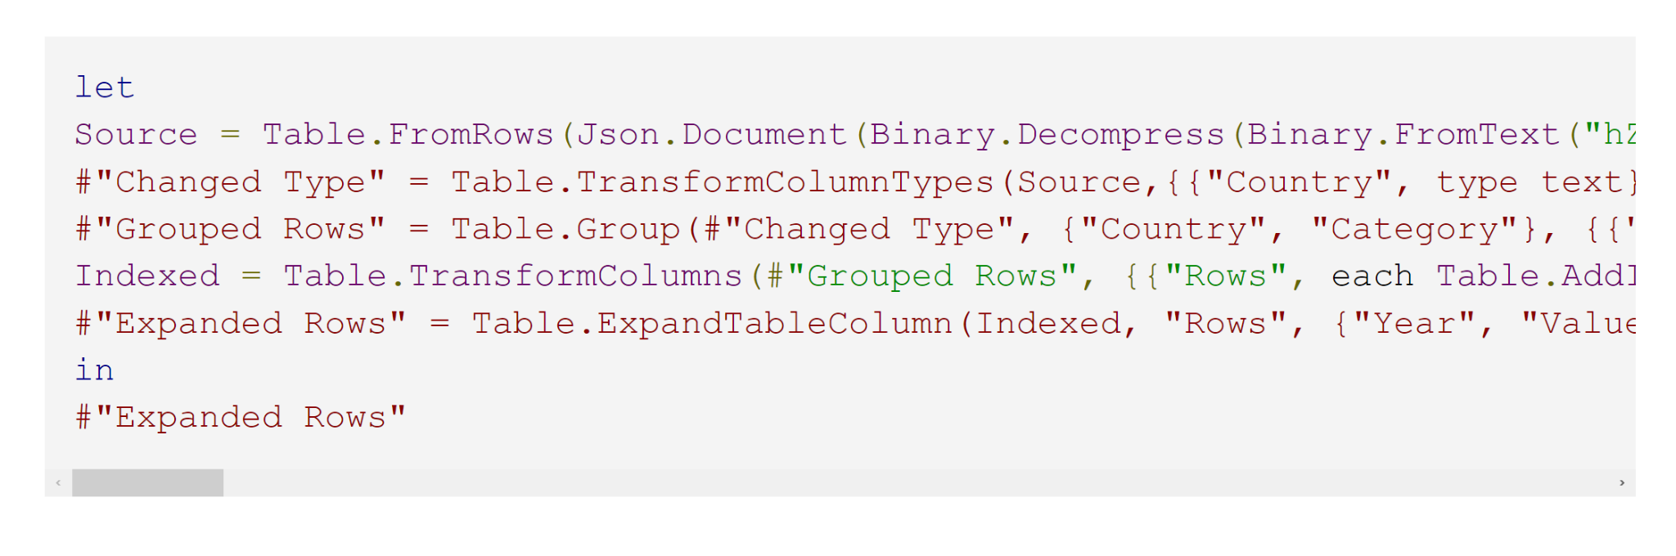
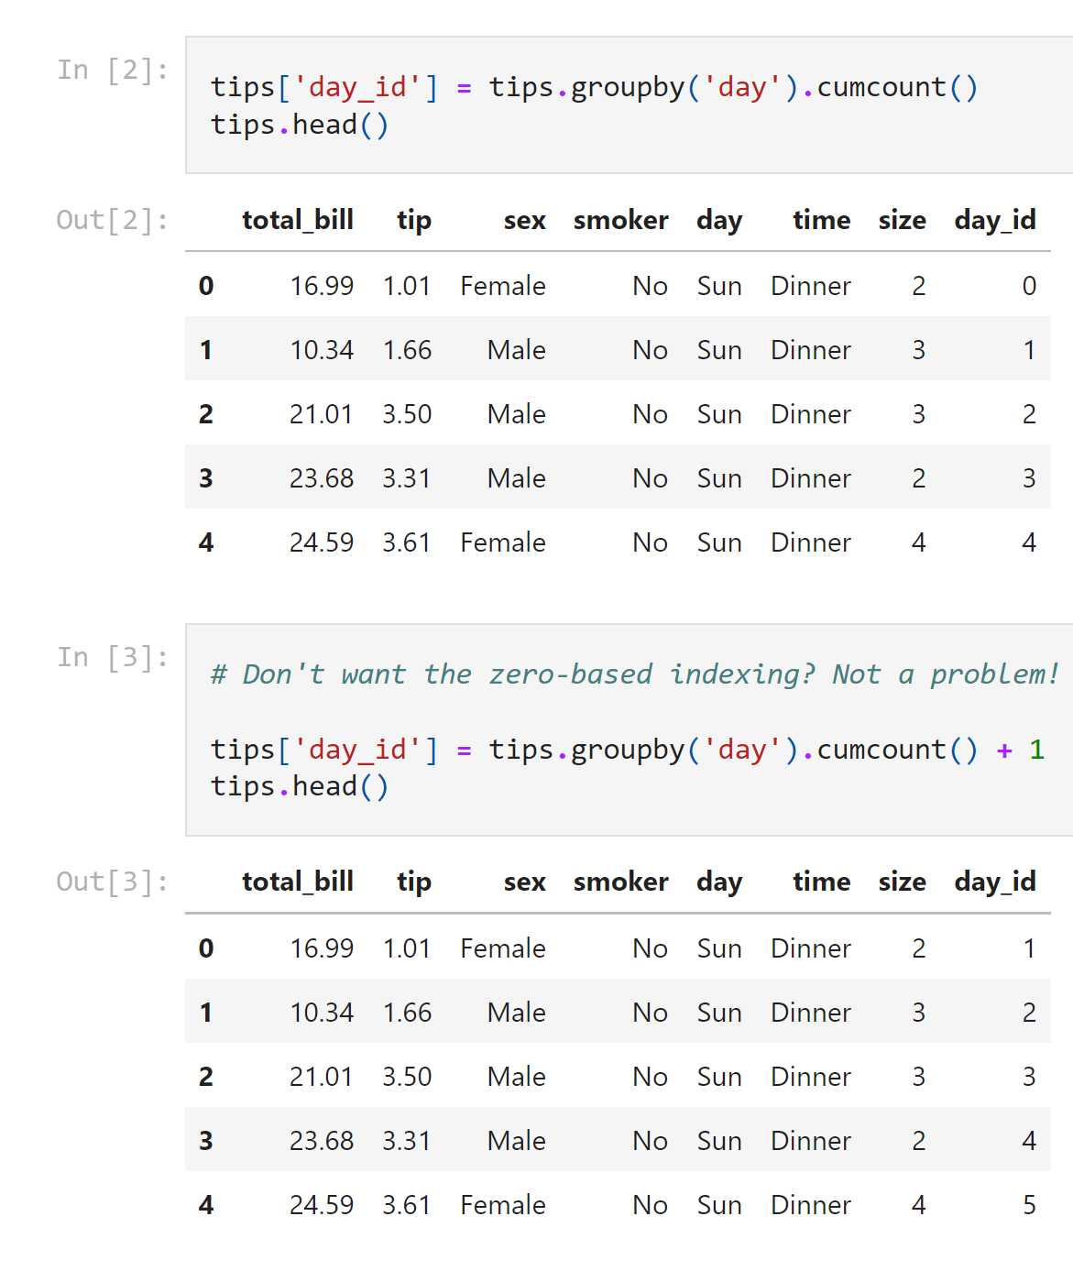
“I want to create a index column by group”
https://datacornering.com/how-to-create-group-index-with-power-query-or-r/
https://gist.github.com/summerofgeorge/59642030a112b90d5b04bebf77f53ddd
Notes:
So this means anyone is free to build on it or redistribute it… and that’s how we’ll get our code

Slide 87
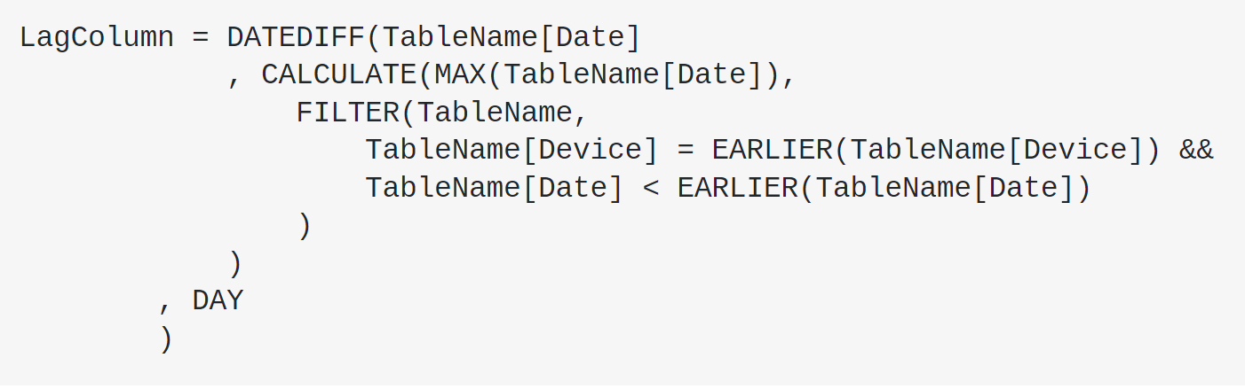
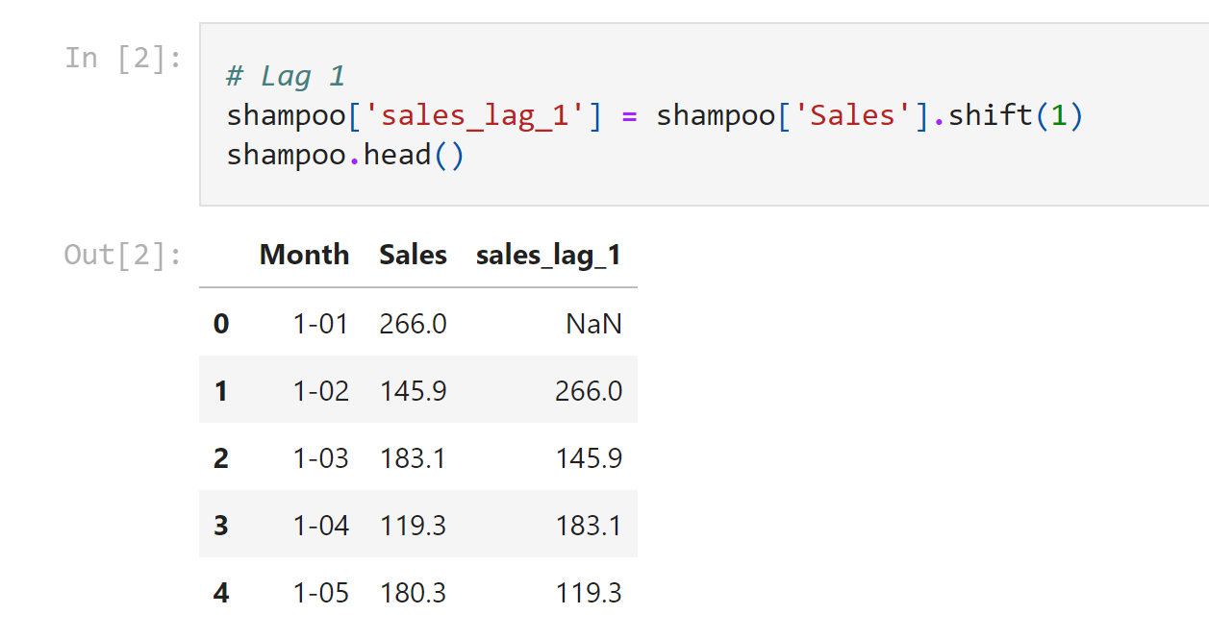
“I want to create a lagged variable”
https://stackoverflow.com/questions/37446950/powerbi-time-lag-calculation-in-dates-using-query-editor
https://gist.github.com/summerofgeorge/a53be111c3d2b4da5ffaf0d732f3bb53
Notes:
So this means anyone is free to build on it or redistribute it… and that’s how we’ll get our code

Slide 88
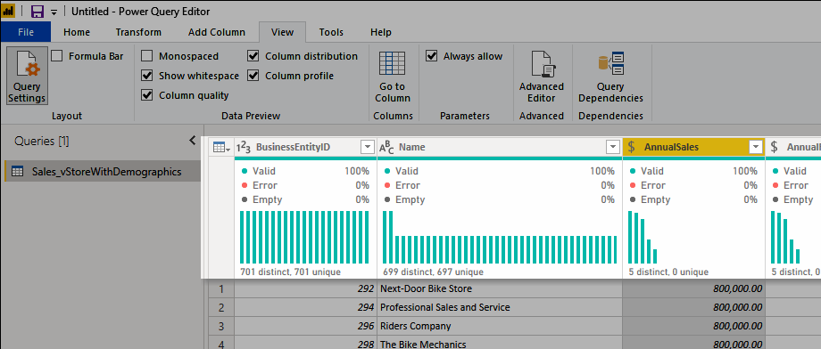
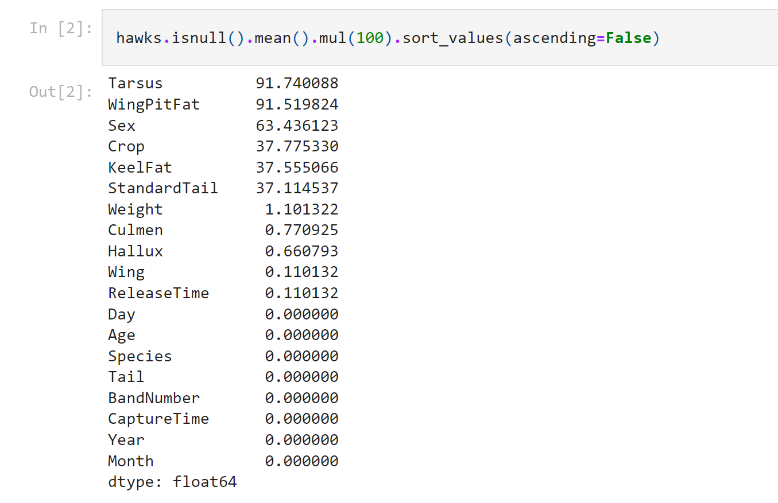
“I want to know what percent of each column are missing values”
https://docs.microsoft.com/en-us/power-query/data-profiling-tools
https://gist.github.com/summerofgeorge/23202b54454af7518dd9fe5c3baec7dc
Notes:
So this means anyone is free to build on it or redistribute it… and that’s how we’ll get our code

Slide 89
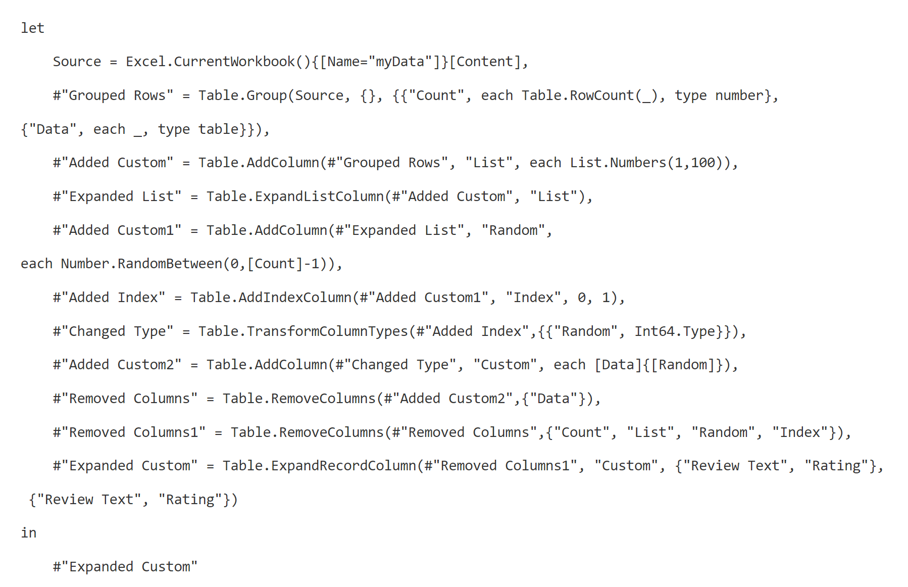
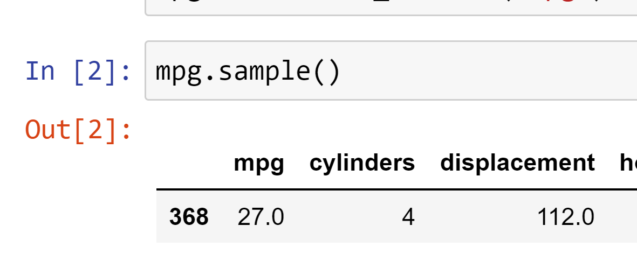
“I want to pick a row at random from my very large dataset”
https://chandoo.org/wp/power-query-random-sample/
https://gist.github.com/summerofgeorge/631ad40ef849886aee6840a497088aa7
Notes:
So this means anyone is free to build on it or redistribute it… and that’s how we’ll get our code

Slide 90
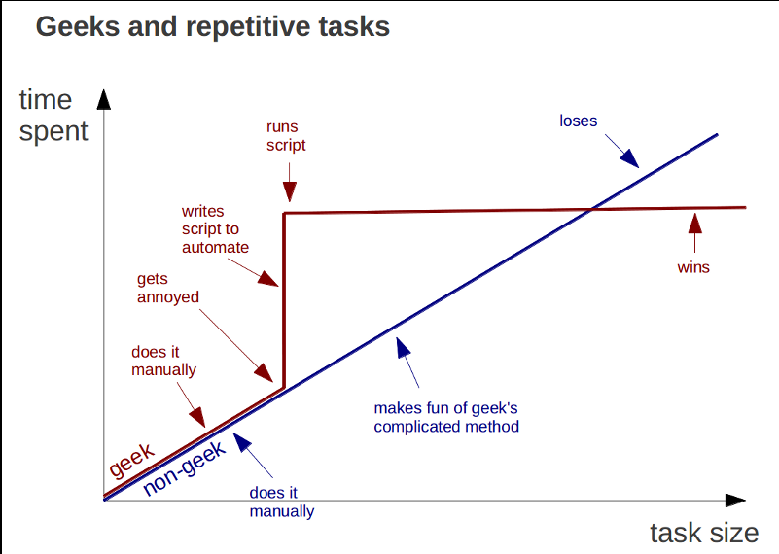
Learning Python is a knowledge investment that pays off
https://marcgg.com/blog/2015/09/30/automate-repetitive-tasks/
Notes:
So this means anyone is free to build on it or redistribute it… and that’s how we’ll get our code

Slide 91
1. Open source means a license to build and distribute
Notes:
Onto the five things now…

Slide 92

What is open source?
“… code that is designed to be publicly accessible—anyone can see, modify, and distribute the code as they see fit.”
- Red Hat, “What is open source?”
https://cloudblogs.microsoft.com/windowsserver/2015/05/06/microsoft-loves-linux/
Notes:
So this means anyone is free to build on it or redistribute it… and that’s how we’ll get our code

Slide 93



Python + Anaconda + Jupyter
The (open) source code
python.org
The “distribution” of code & apps
anaconda.com
The browser-based app
jupyter.org
Notes:
OK now remember that being open source means anyone is free to repackage and redistribute code. In the case of Python the official source code lives with the Python foundation and can be found there. It’s more common however to download from the Anaconda _distribution_ of that code. One of the reasons why is Anaconda comes with some goodies that don’t come with the raw Pyhon installation. One of those is the Jupyter notebook, which is a browser-based app we’ll be using to work with Python.

Slide 94

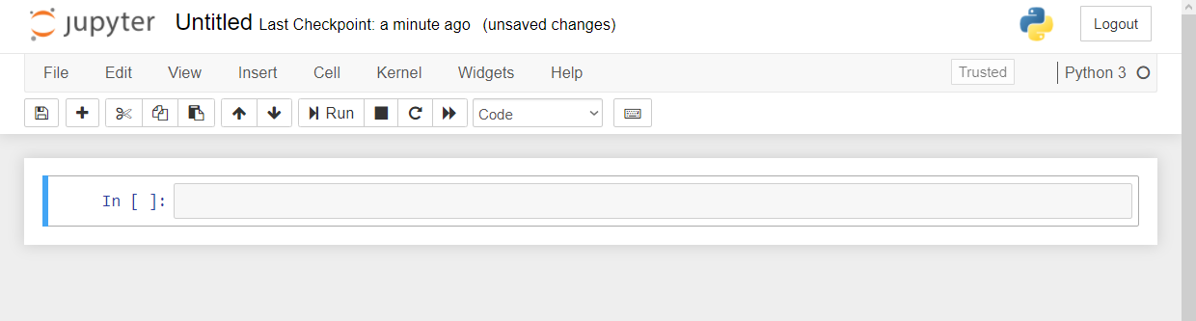

Demo
File: downloading-anaconda.docx
Download Anaconda (or click “launch binder”…)
Start with Jupyter at 1+1…
Menu bar
Toolbar
Code cell
Notes:
OK again, what I want to do here is just show you the basics of working with Jupyter. You will see in the repo there is an option to launch an interactive session, so do that and let’s navigate the four sections of Jupyter and get comfortable working there.
In the demo you’ll get a tour of the notebook and how to work a bit with functions and objects.
Possibly come up with some demo notes for this

Slide 95
2. It’s finnicky… or maybe logical?

Slide 96
Demo
File: thing-2.ipynb
How does Python handle
Case sensitivity?
Indexing?
Whitespace?
Notes:
OK so what we are going to do here is go back to your session or open a new one. Go to the diamonds.r dataset. And let’s actually conduct the analysis that was hinted at earlier.

Slide 97
3. There’s a package for that!

Slide 98

The package two-step…
Install the package if needed
conda install packagename
pip install packagename
Open the package
import packagename
More: https://stringfestanalytics.com/sourcing-python-packages/
Notes:
Now another thing unique to open source programs is this idea of packages. You can kind of think of this as like add-ins for Excel – the analogy I like to use is as apps on a phone.

Slide 99
You won’t get far without these…
Package | Description
numpy | Designed for numerical computing
pandas | Designed to work with panel data and other tabular data structures (think rows and columns. This package leverages code from numpy.
matplotlib | a popular package for data visualization
seaborn | another package for data visualization, built on top of matplotlib and designed to work well with pandas.

Slide 100
Demo
File: thing-3.ipynb
Import from the Standard Library
Confirm packages available to you
Import and alias pandas
Notes:
OK again, what I want to do here is just show you the basics of working with Jupyter. You will see in the repo there is an option to launch an interactive session, so do that and let’s navigate the four sections of Jupyter and get comfortable working there.
Possibly come up with some demo notes for this

Slide 101
Questions?
Notes:
Any questions so far about using R?
Again I just want to show you how easy it is to get up and running there as an Excel user and what to expect when working with open source programs.
Now I guess one of the questions I might have in your shoes is what’s the big deal, we can do the same kind of stuff with Power Query. So I want to acknowledge that.

Slide 102
4. It can augment and automate Excel

Slide 103
So many choices, so many use cases…
Package | Pros | Cons
xlsxwriter | Write almost anything from Excel from Python (data, formats, workbook settings, etc.) | Writes to Excel only/no reading
xlwings | Feature-rich: write data/UDFs, call VBA procedures, robust debugging tools | Local Python/Excel downloads needed
openpyxl | Read and write .xlsx, .xlsm Excel files | Limited ability to edit files
pyxlsb | Read and write .xlsb files | Limited features
xlrd, xlwt, xlutils | Can work with .xls files | Limited features
Notes:
Now another thing unique to open source programs is this idea of packages. You can kind of think of this as like add-ins for Excel – the analogy I like to use is as apps on a phone.

Slide 104
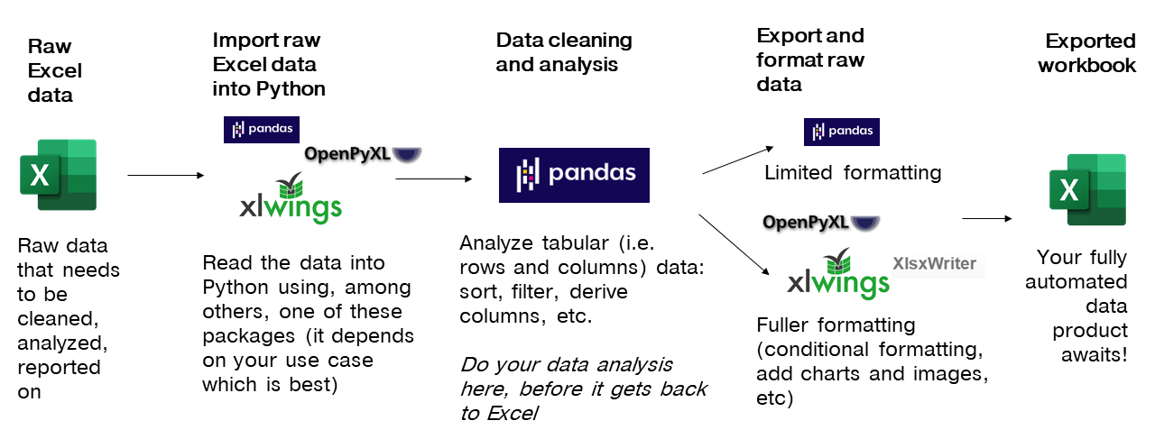
Notes:
Now another thing unique to open source programs is this idea of packages. You can kind of think of this as like add-ins for Excel – the analogy I like to use is as apps on a phone.

Slide 105
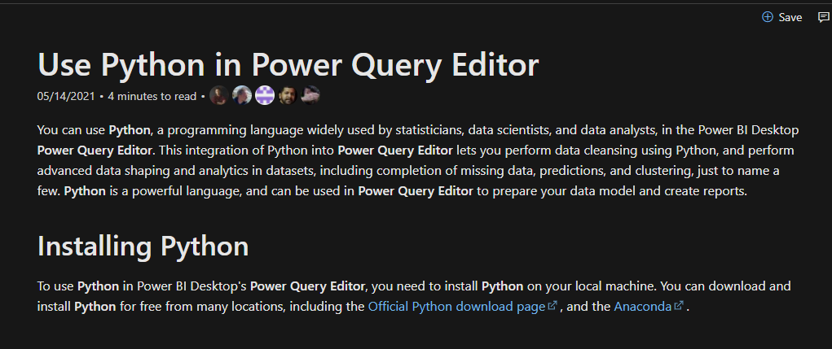
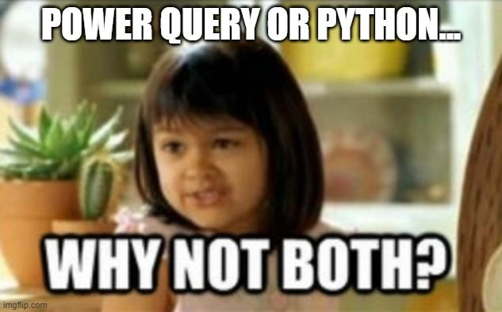
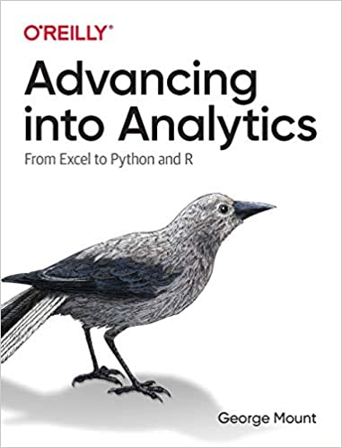
You’re not leaving the stack…
Notes:
One of the things that people get confused about is why learn Python if you’re getting into Power Query… or which to focus on.
You’re not leaving Microsoft’s stack. I have some documentation and a great book here. Now of course these are more about PowerBI but there’s every indication there’s more to come with Excel.

Slide 106
5. It’s not worth panicking over
Notes:
Now this is scary, it’s literally learning another language!

Slide 107
Demo
File: thing-5.ipynb
Some ways to get help from right inside Jupyter…
Notes:
OK again, what I want to do here is just show you the basics of working with Jupyter. You will see in the repo there is an option to launch an interactive session, so do that and let’s navigate the four sections of Jupyter and get comfortable working there.
Possibly come up with some demo notes for this

Slide 108
Finale

Slide 109


Let’s play DataBaseball! data-baseball.ipynb
2. Profile the data
3. Analyze the data
1. Import the data
4. Export results to Excel
Notes:
Start by: 9:35
Link to notebook: https://github.com/summerofgeorge/modal-python-da/blob/main/modal-python-big-picture.ipynb
Read in data from Sean Lahman’s baseball database
Visualize and explore records – what does this data look like? What can it tell us? What do we need to do to get it clean?
Salary analysis: Do higher payrolls attract larger crowds?
Produce presentation-worthy Excel summary workbook from Python

Slide 110
Questions about Python?
Notes:
Any questions so far about using R?
Again I just want to show you how easy it is to get up and running there as an Excel user and what to expect when working with open source programs.
Now I guess one of the questions I might have in your shoes is what’s the big deal, we can do the same kind of stuff with Power Query. So I want to acknowledge that.

Slide 111
Event survey: https://forms.office.com/r/0ZnD0LxpZy

Slide 112

Free white paper
Five Things Excel Users Should Know About Python:
https://stringfestanalytics.com/five-things-python-excel/
Notes:
By the end of this book, you should be able to conduct exploratory data analysis and
hypothesis testing using a programming language.

Slide 113
Want more?
Read Advancing into Analytics: https://stringfestanalytics.com/book/
Read for free on O’Reilly’s website
Or pick up a paperback/ebook
Please leave a review!
Notes:
By the end of this book, you should be able to conduct exploratory data analysis and
hypothesis testing using a programming language.

Slide 114
THANK YOU
george@stringfestanalytics.com
linkedin.com/in/gjmount
stringfestanalytics.com/contact
https://swiy.co/mv-python

